Slide 1
Biodiversity Project
By
Shaun Li

Slide 2
Basic Info of the Data
There are four sections of this Data set: Category, Scientific name, Commmon names, and Conservation status.
Category: gives the creature’s specific category
Scientific name: gives the creature’s scientific name.
Common names: these creatures are common known as some names.
Conservation status: whether or not this animal’s conservation status.

Slide 3
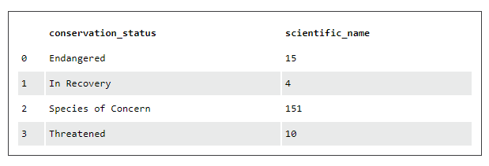
After we analyzed species conservation status

Slide 4
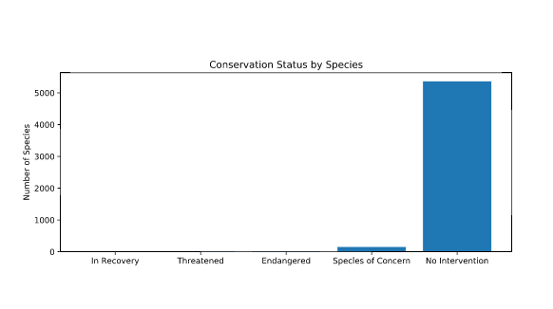
Species are in Danger
There are 151 kind animals that we need to be concerned.

Slide 5
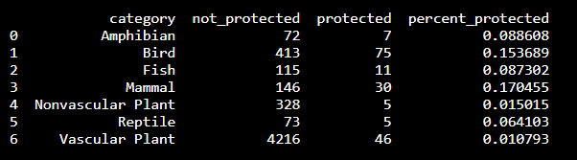
The percentage of protected animal are really low

Slide 6
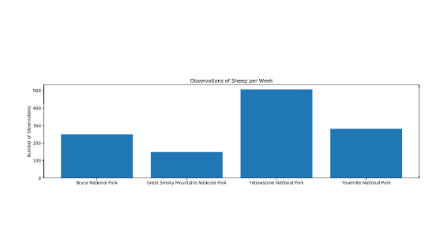

Slide 7
We have to pay more attention to animals.
Many of them are in danger.

